Slide 1


Slide 2
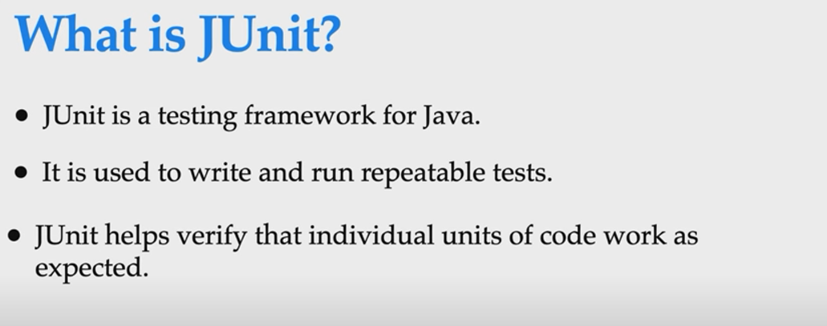

Slide 3
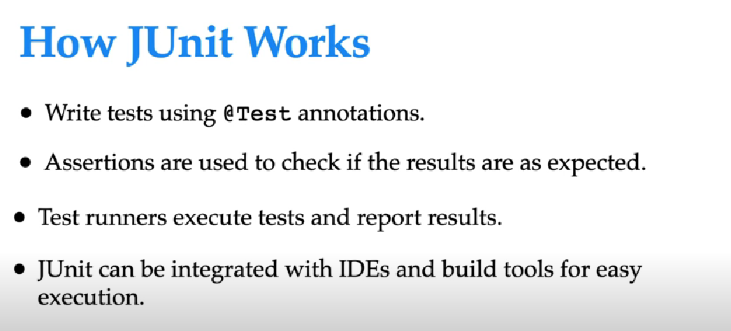

Slide 4
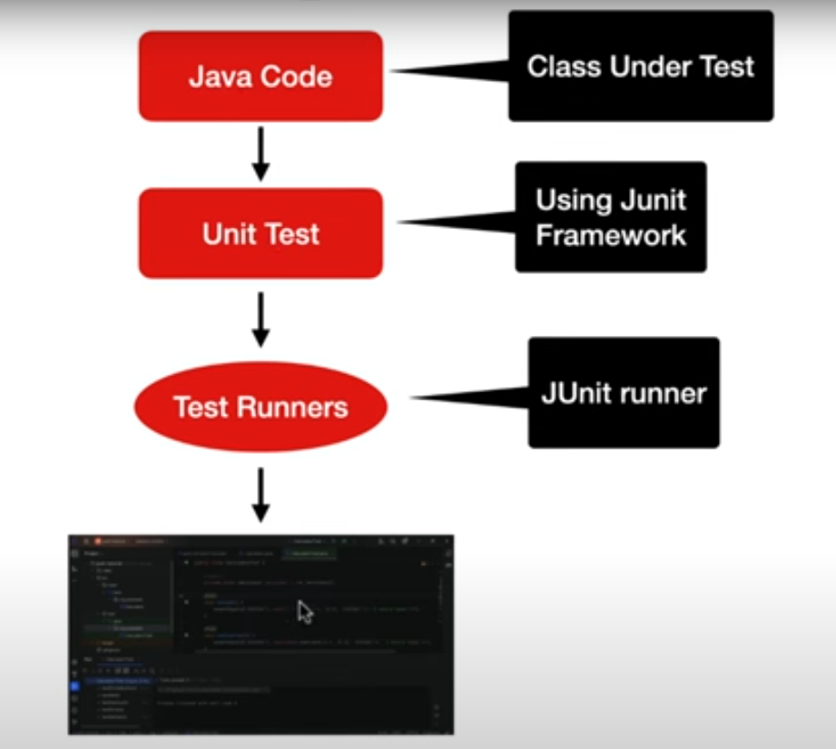

Slide 5
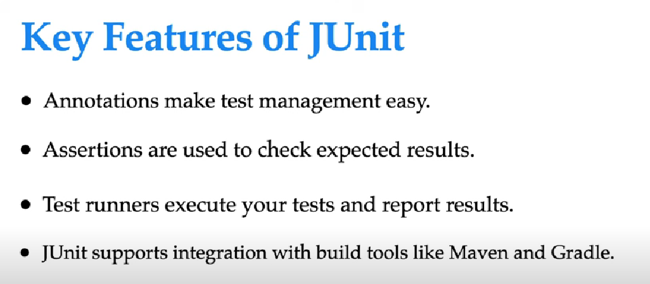

Slide 6
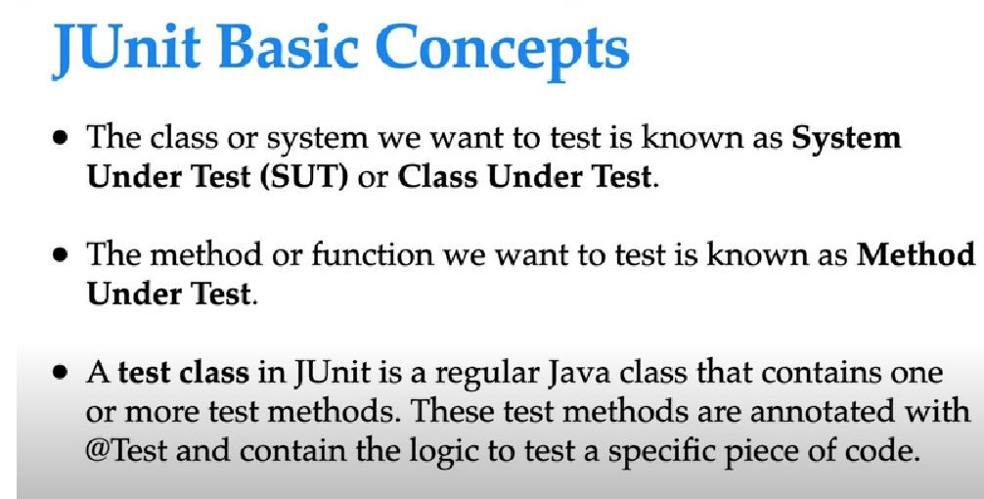

Slide 7
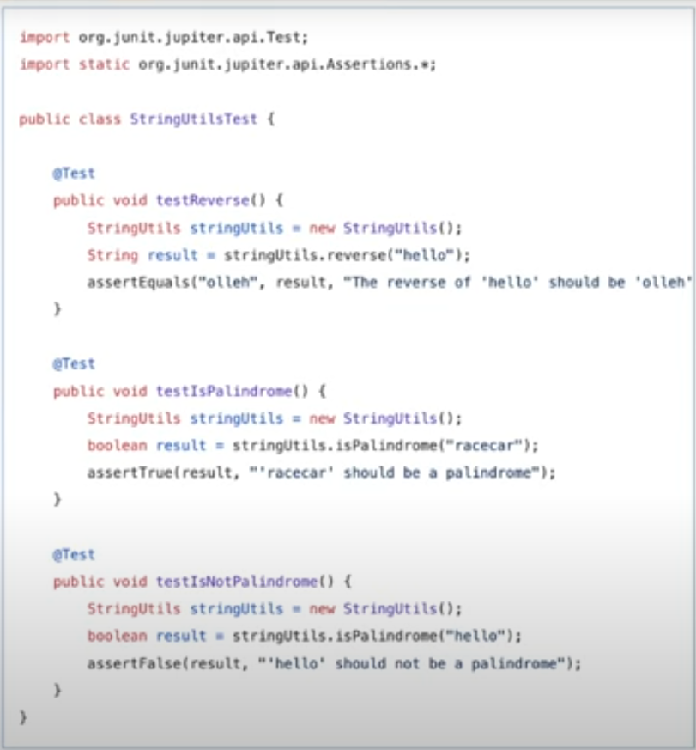

Slide 8
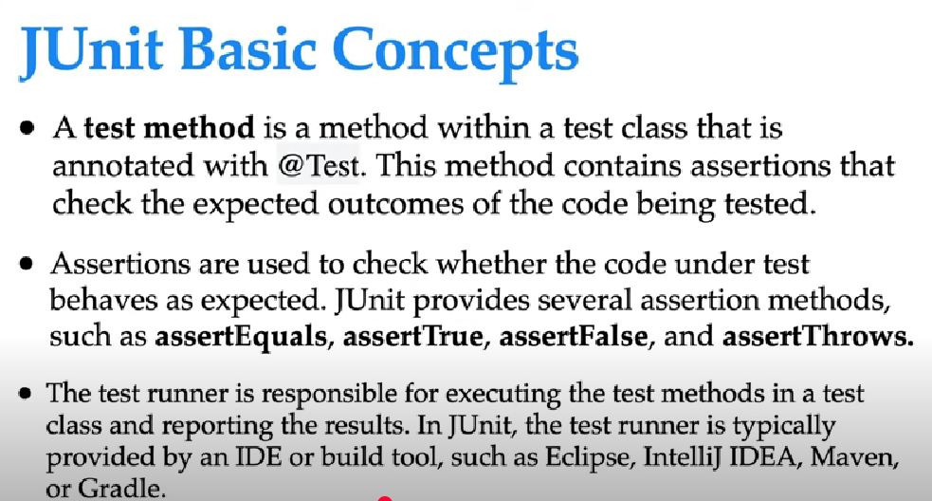

Slide 9
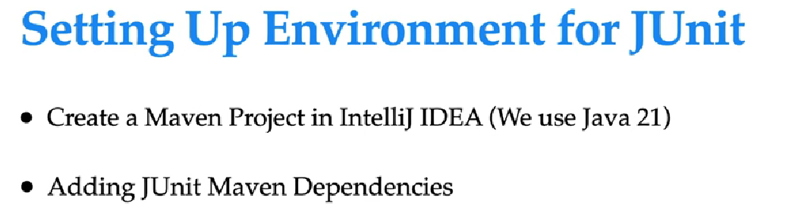

Slide 10
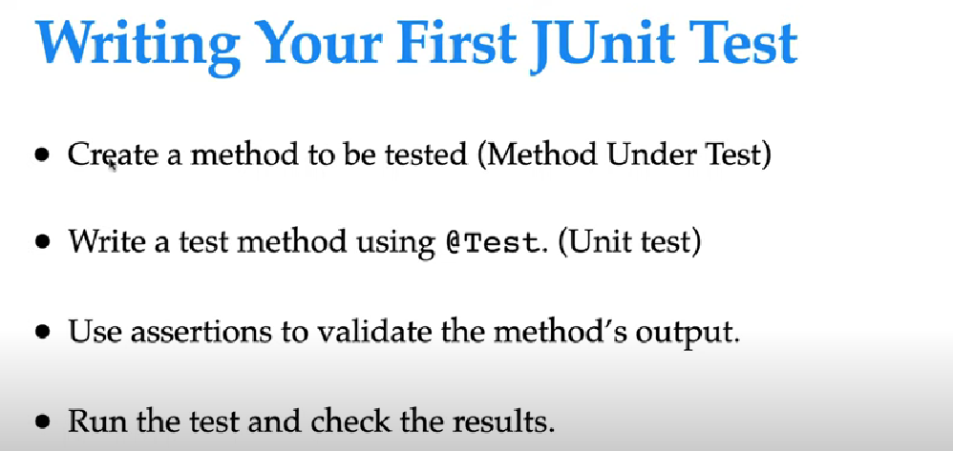

Slide 11
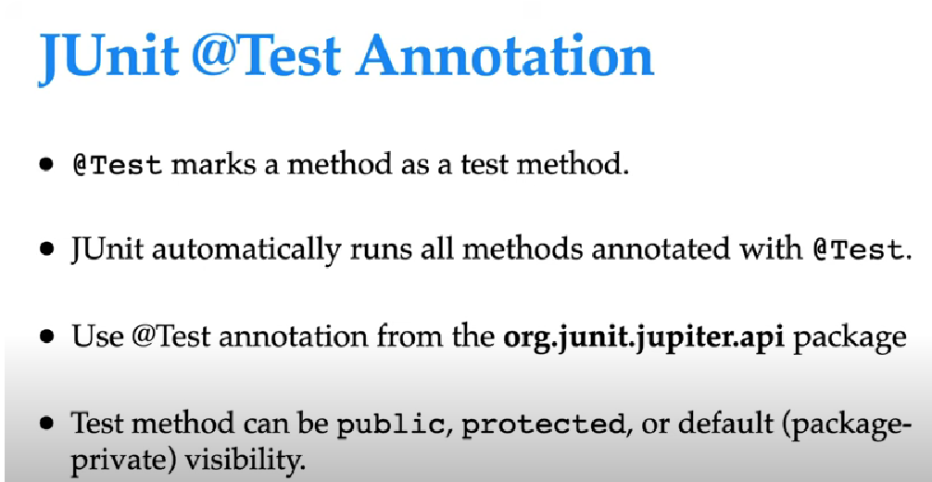

Slide 12
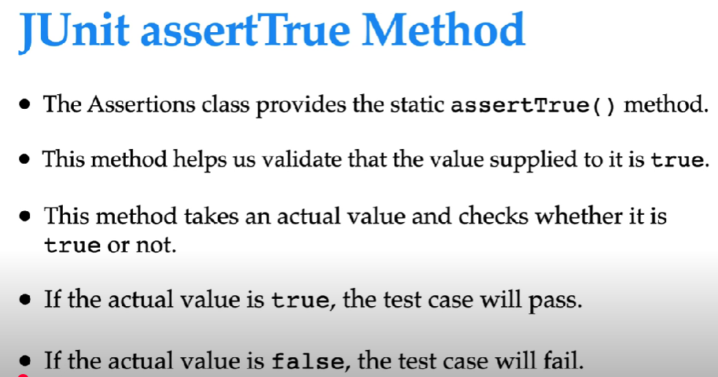

Slide 13
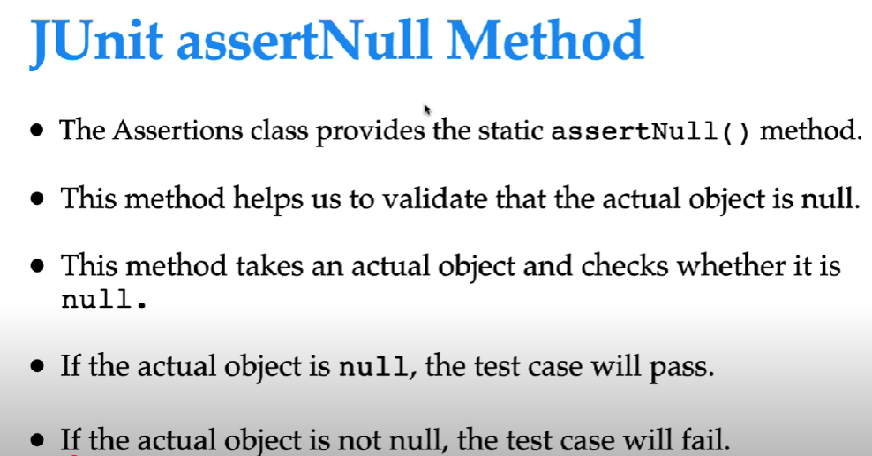

Slide 14
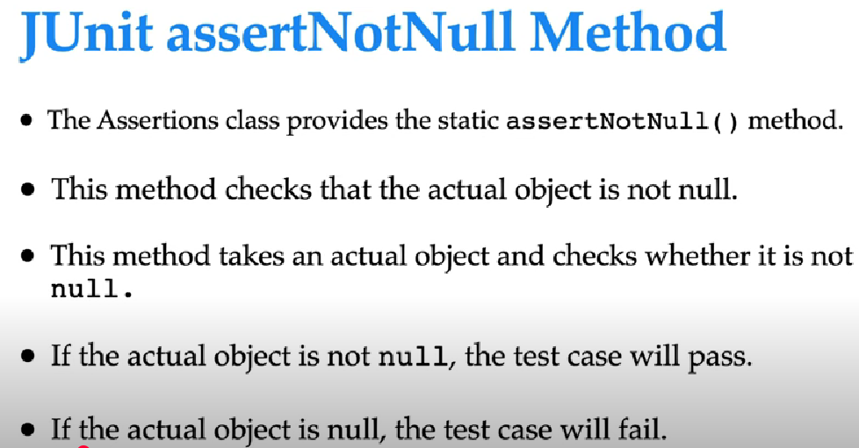

Slide 15
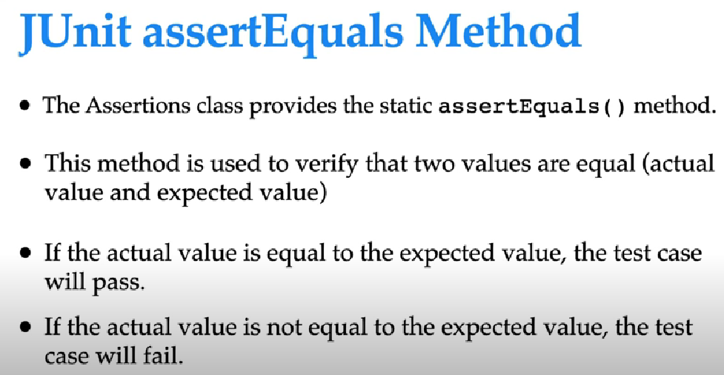

Slide 16
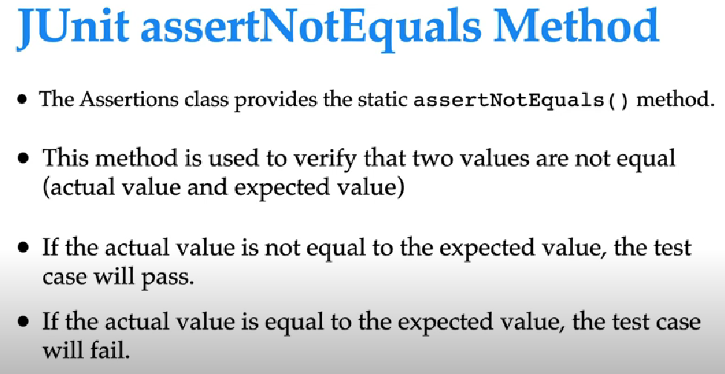

Slide 17
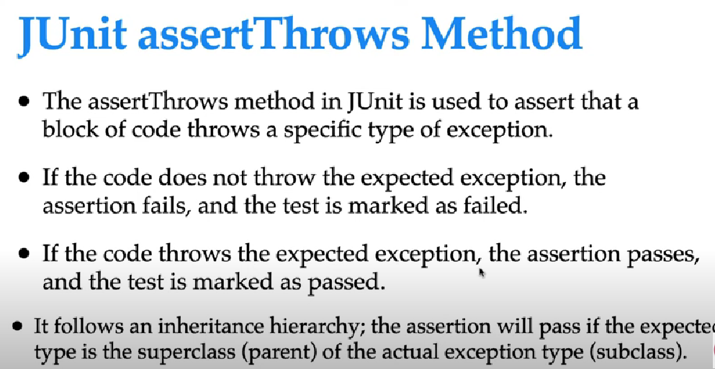

Slide 18
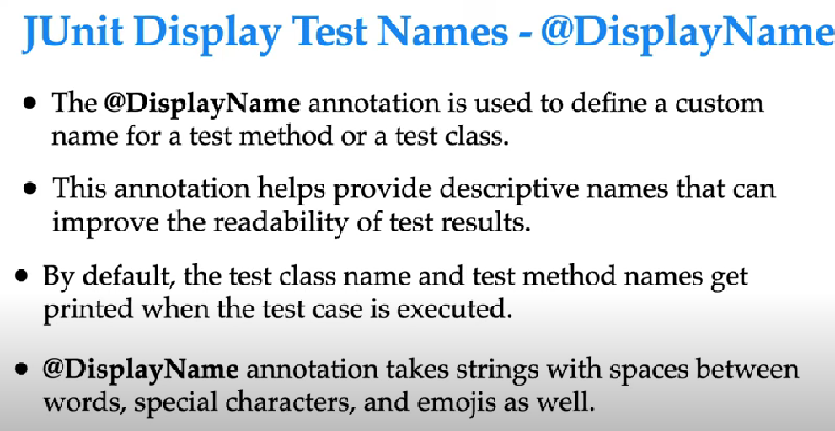

Slide 19
Parameterized Tests
Parameterized tests with
@ParameterizedTest
@ValueSource
@CsvSource
@CsvFileSource

Slide 20
Boundary and Edge Cases
Age=18-60
Boundary cases:- 18,17,19, 59,60,61
Min,min+-1,max,max+-1
Edge Cases:- 0,negative

Slide 21
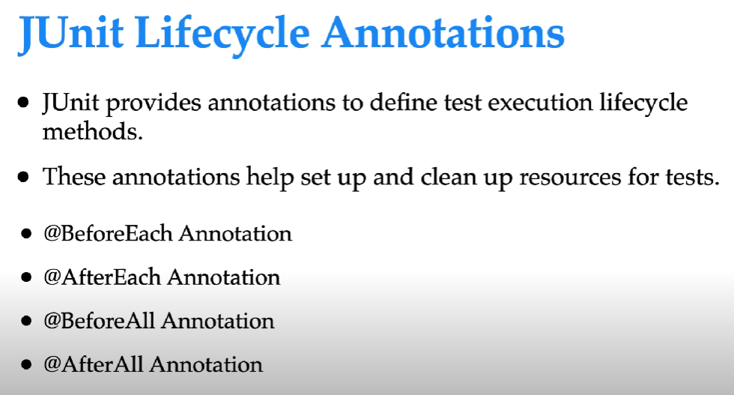

Slide 22
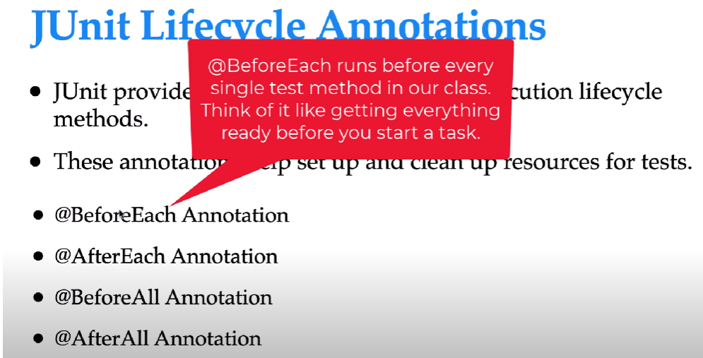

Slide 23
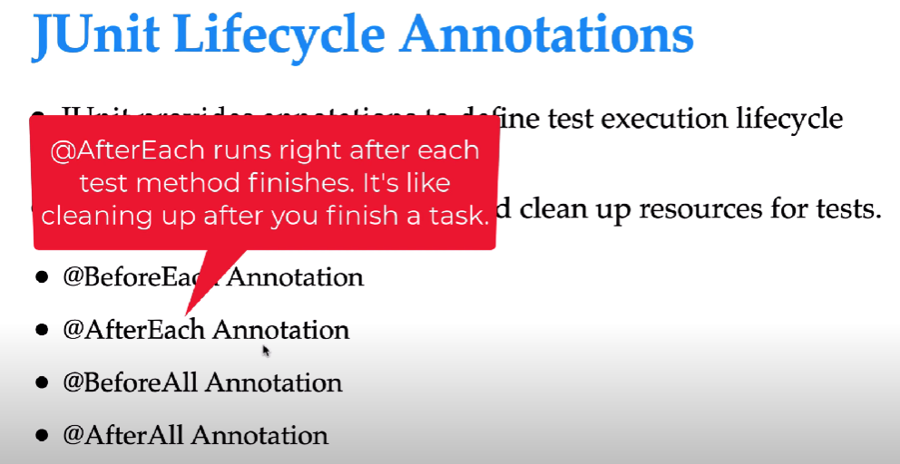

Slide 24
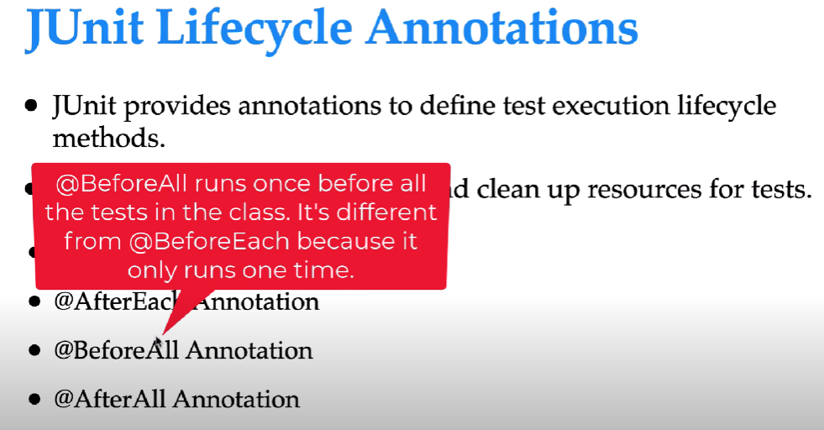

Slide 25
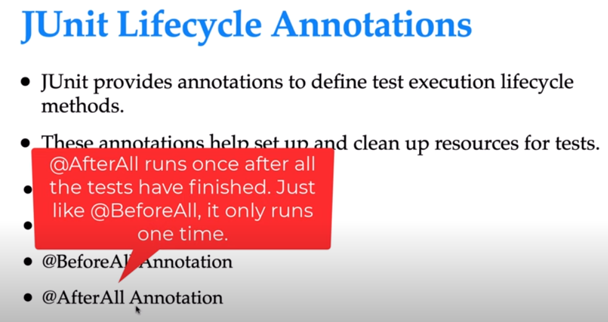

Slide 26
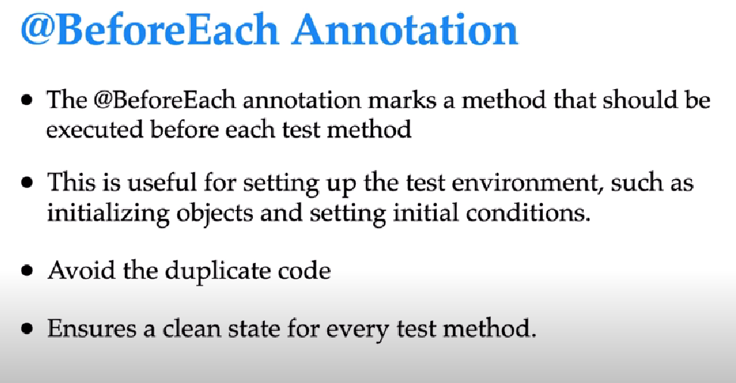

Slide 27
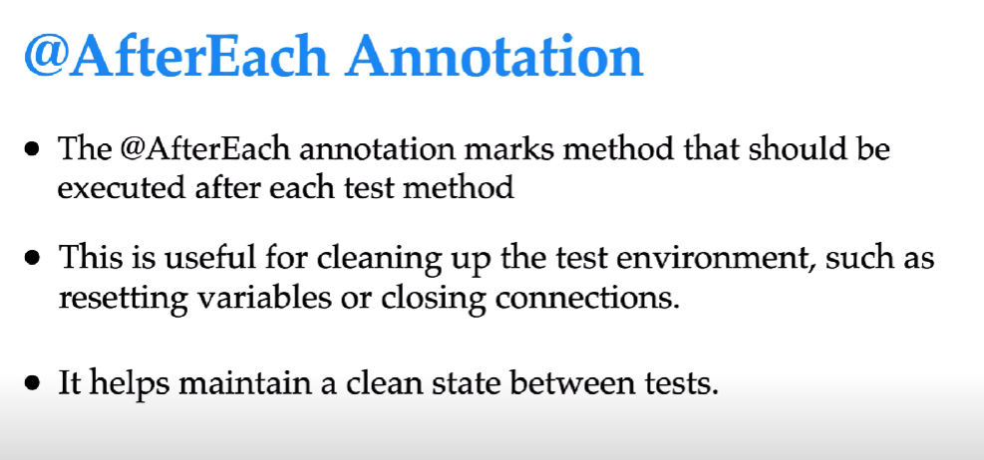

Slide 28
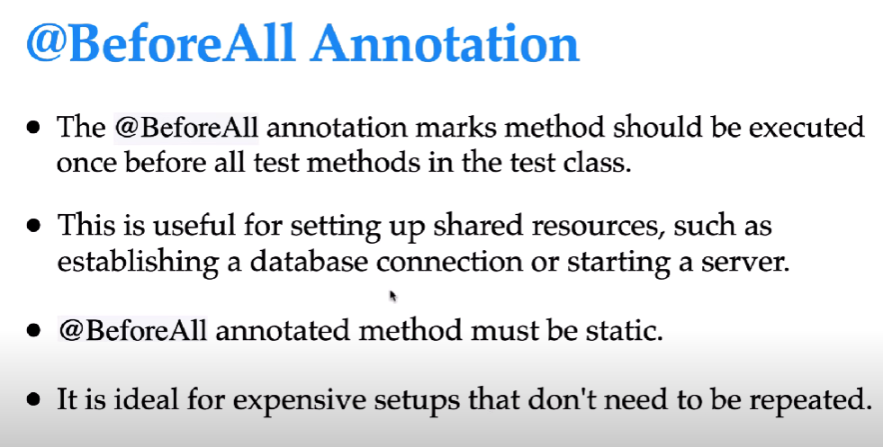

Slide 29
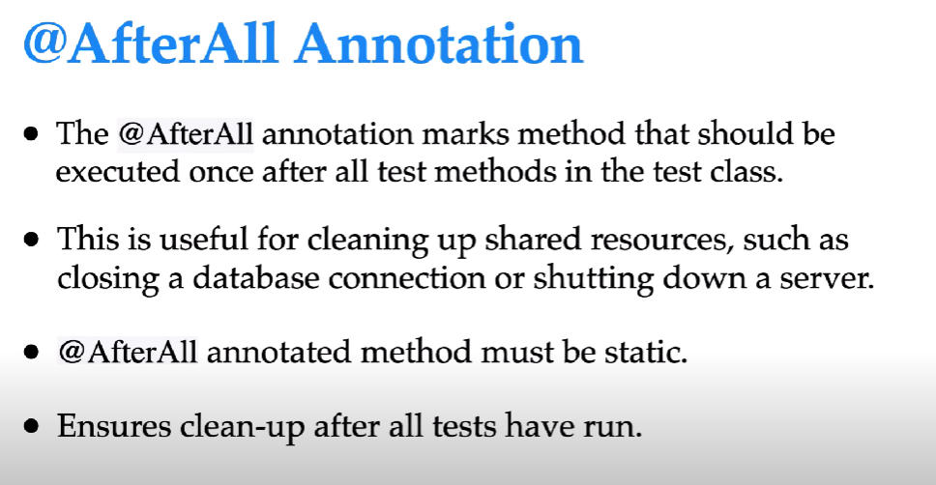

Slide 30
JUnit Mockito
What is Mockito in JUnit?
Mockito is a mocking framework for unit testing in Java. It is often used along with JUnit to write tests where you don’t want to depend on real implementations (like databases, APIs, or external services).
Instead of calling the real object, Mockito creates a mock object (fake object) that mimics the behavior of the real one.
This allows you to isolate the class under test and focus only on its logic.

Slide 31
Why do we use Mockito?
Isolation → Test the logic of one class without depending on external systems.
Control → You decide what the mock should return or throw.
Verification → Check whether a method was called, how many times, and with what arguments.
Speed → No database/network needed → faster tests.

Slide 32


Slide 33
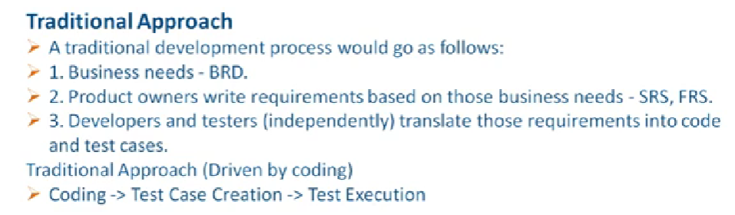

Slide 34
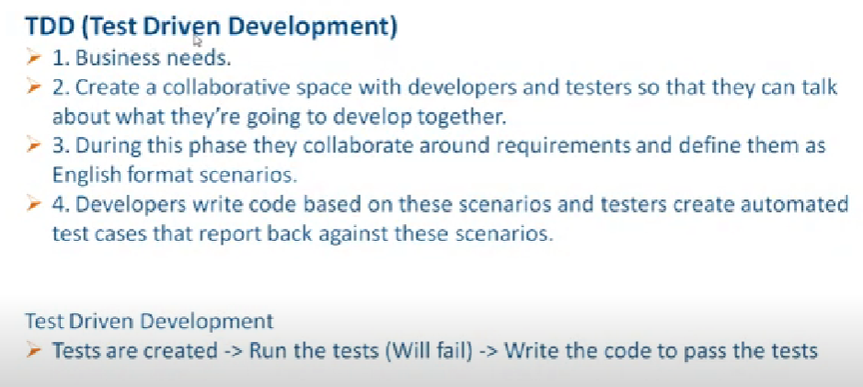

Slide 35
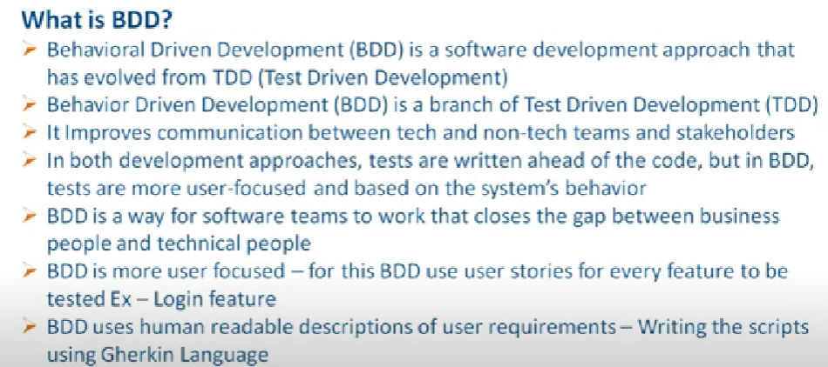

Slide 36
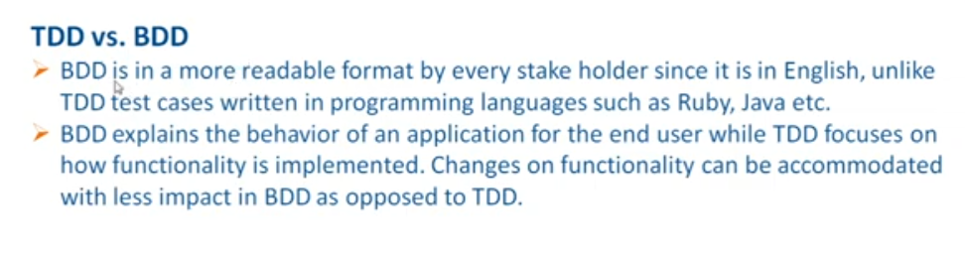

Slide 37
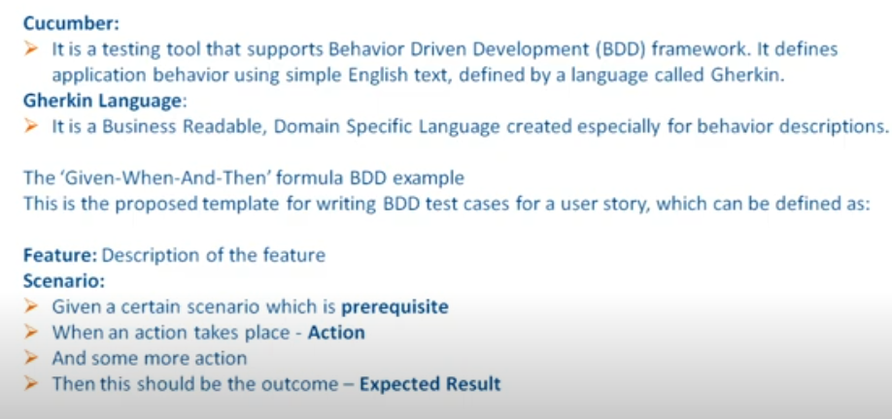

Slide 38
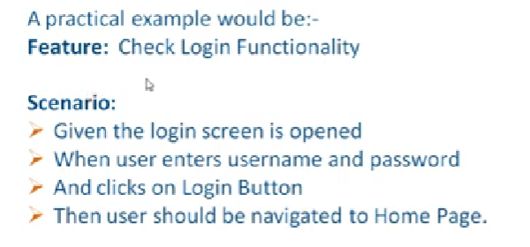

Slide 39
